Slide 1
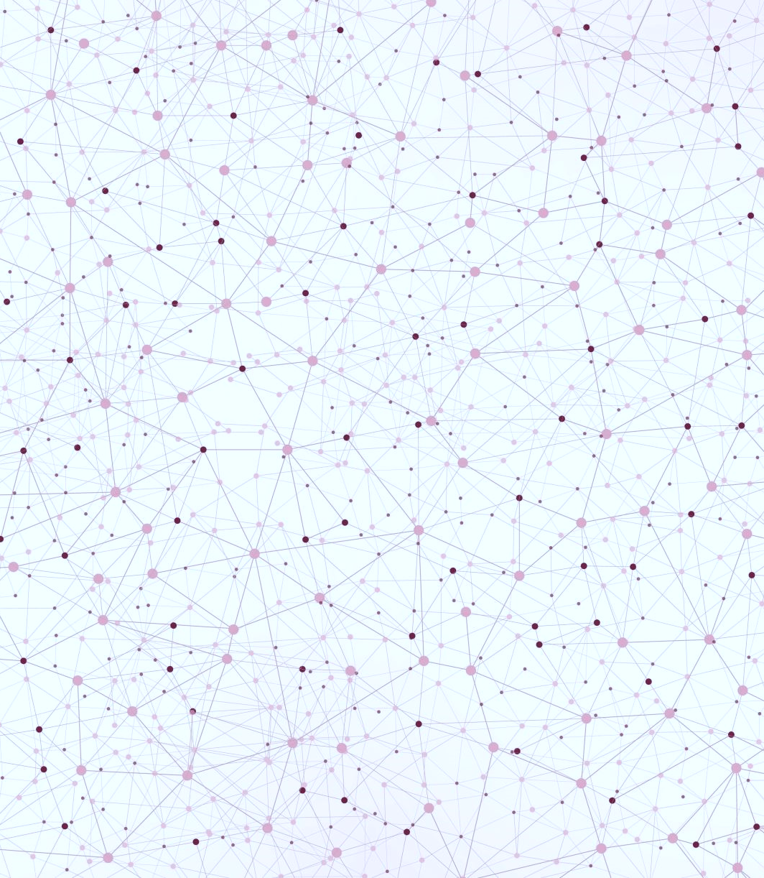
Workflow for creating a CRISPR - Engineered model In a Simple basic research Laboratory
Munuse C Savash Ishanzadeh
Oxford University

Slide 2
CRISPR Workflow
Establishing a project
Identify a target gene
Guide design
Cell culture
Transfection
Selection
Isolation
Phenotyping techniques

Slide 3
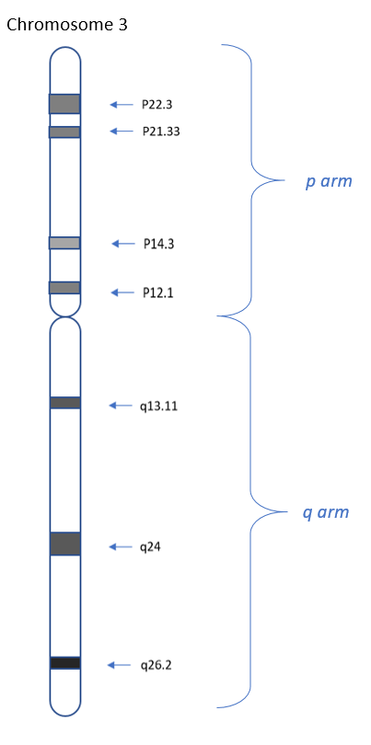
Establishing a project and target gene
Targeted the MMR gene, MLH1 of human chromosome 3
Defective gene can result in hereditary non-polyposis colon cancer and Lynch syndrome
Cellular model used was a childhood bone cancer cell line tagged with a green fluorescent protein.

Slide 4
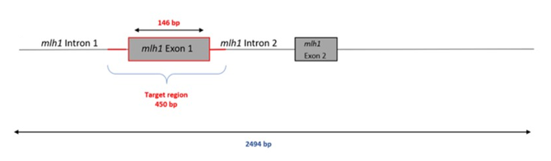
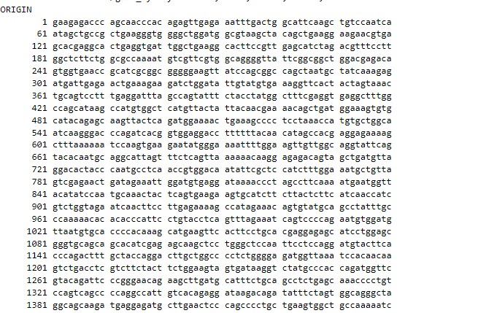
Guide design
Target region
Access the genetic sequence of your target location.
Design your guide on sites such as Benchling.
Snippet from Ensembl

Slide 5
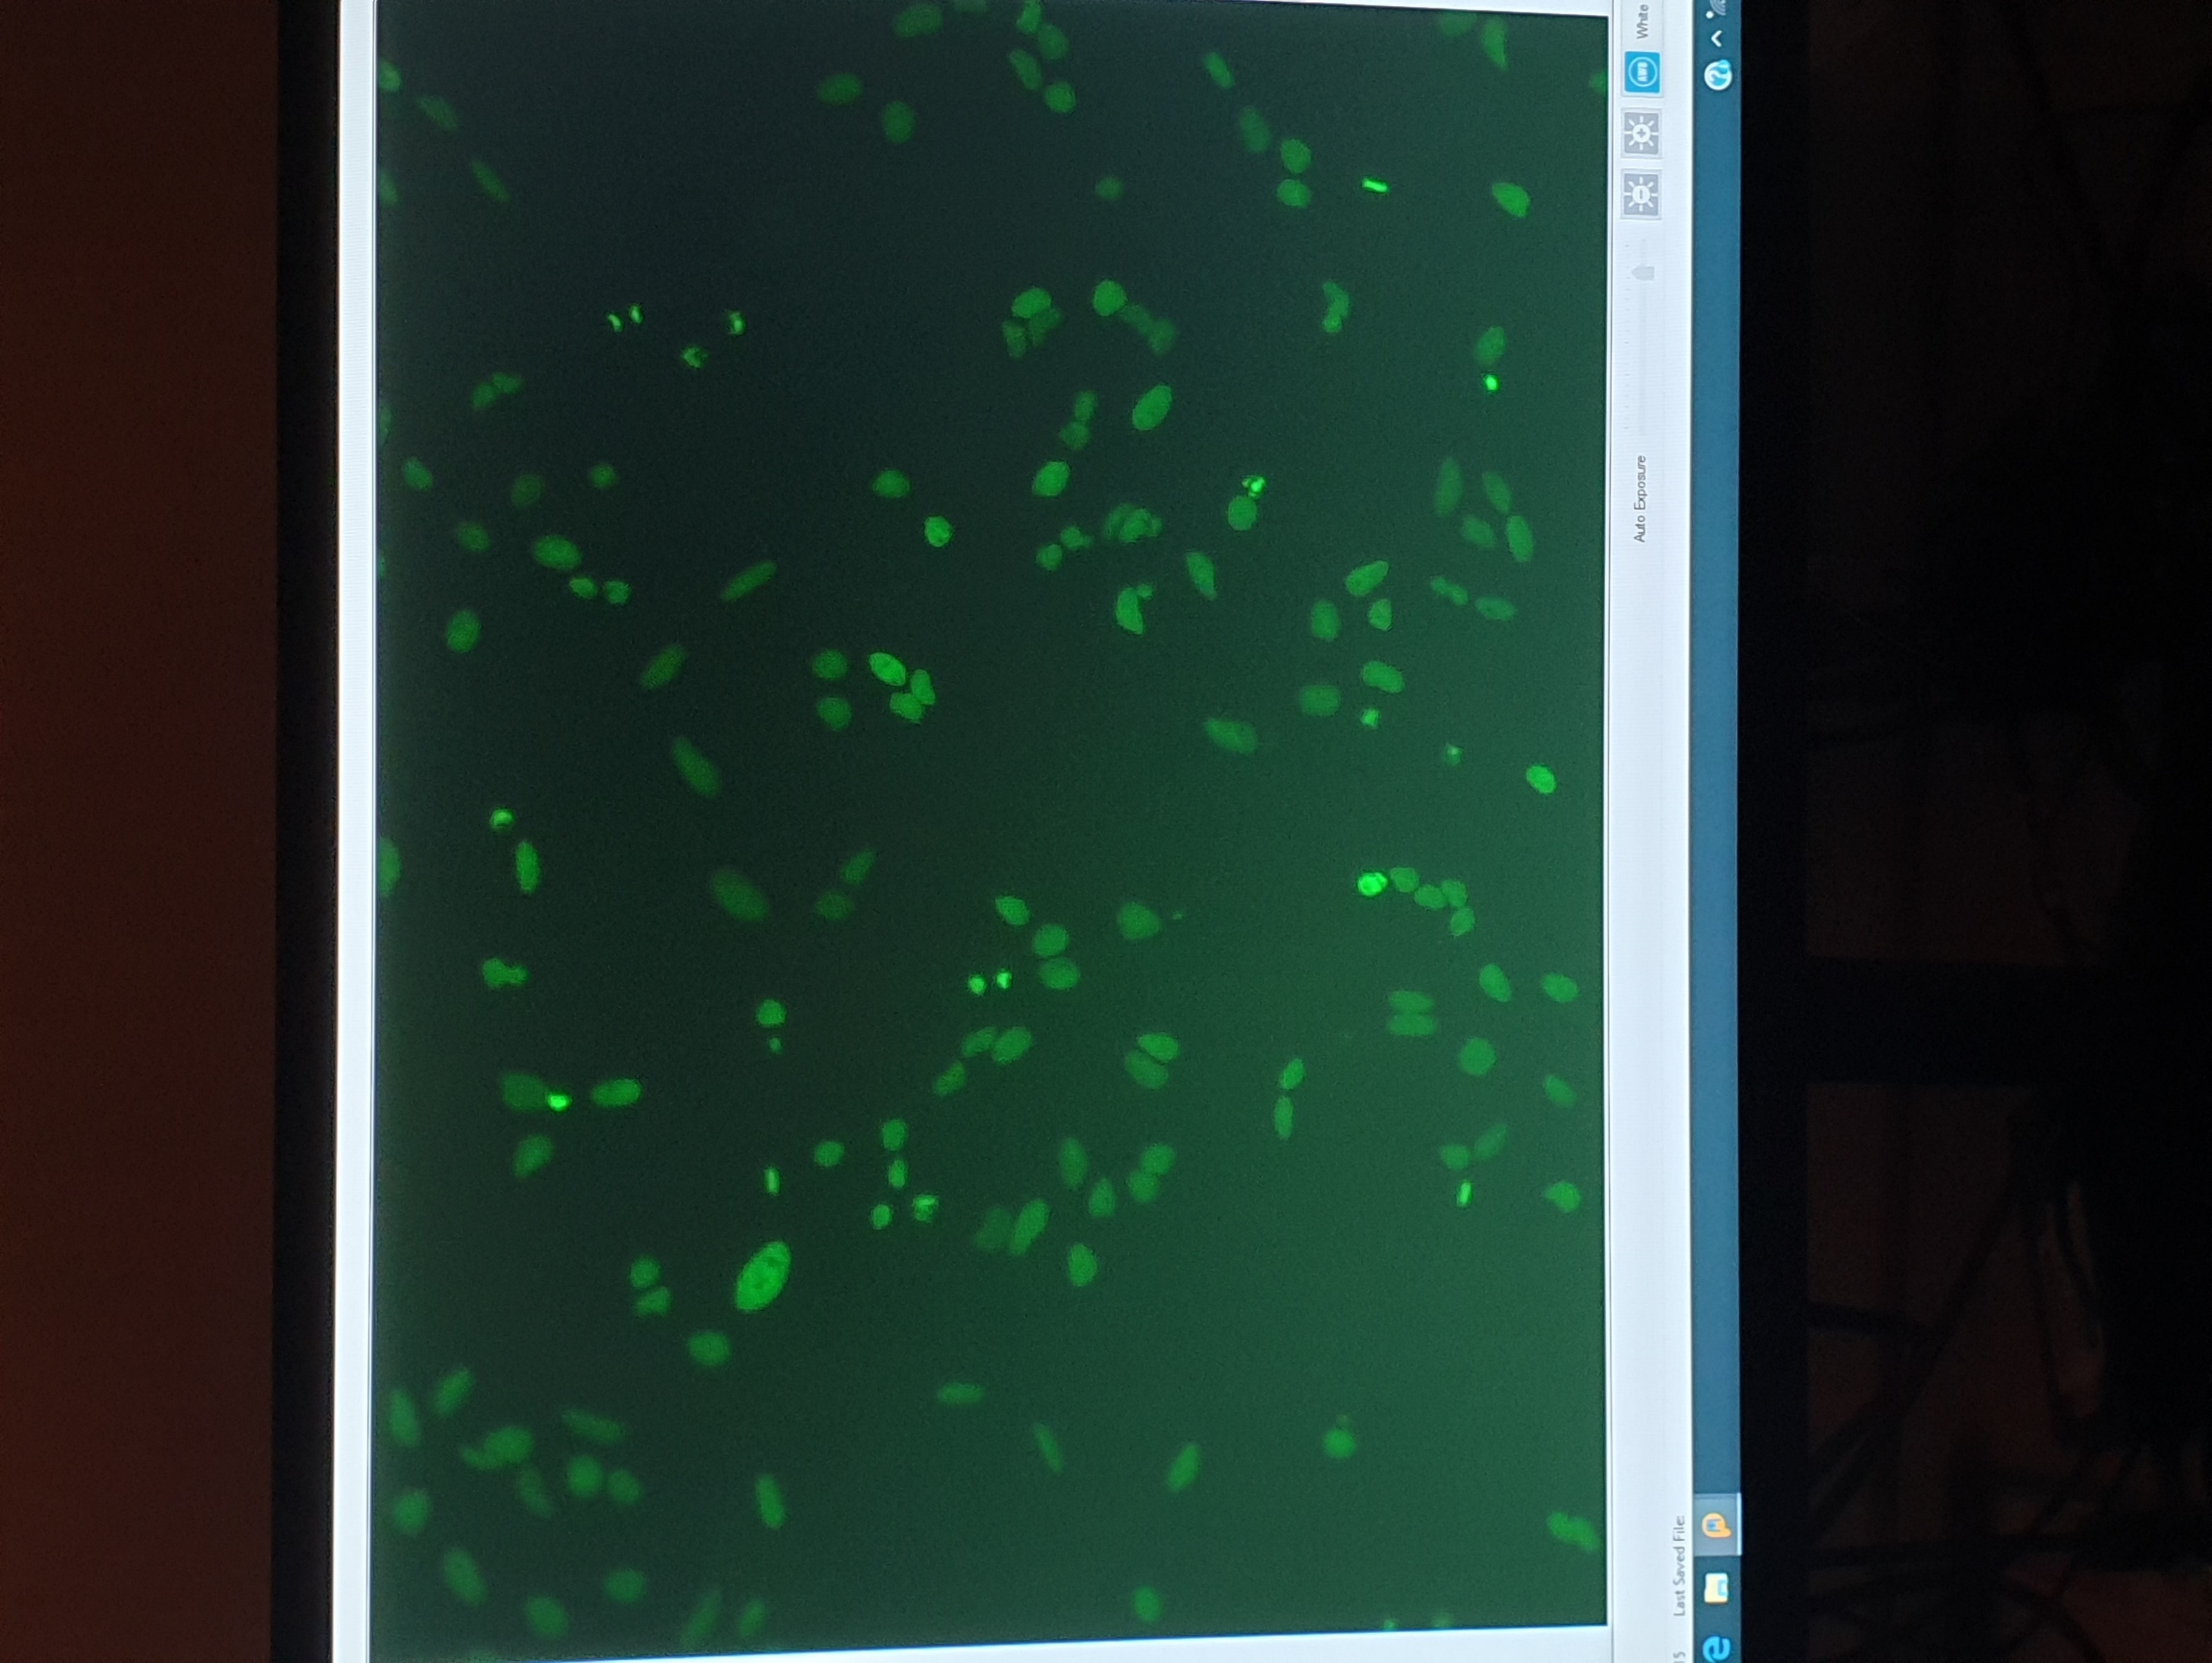
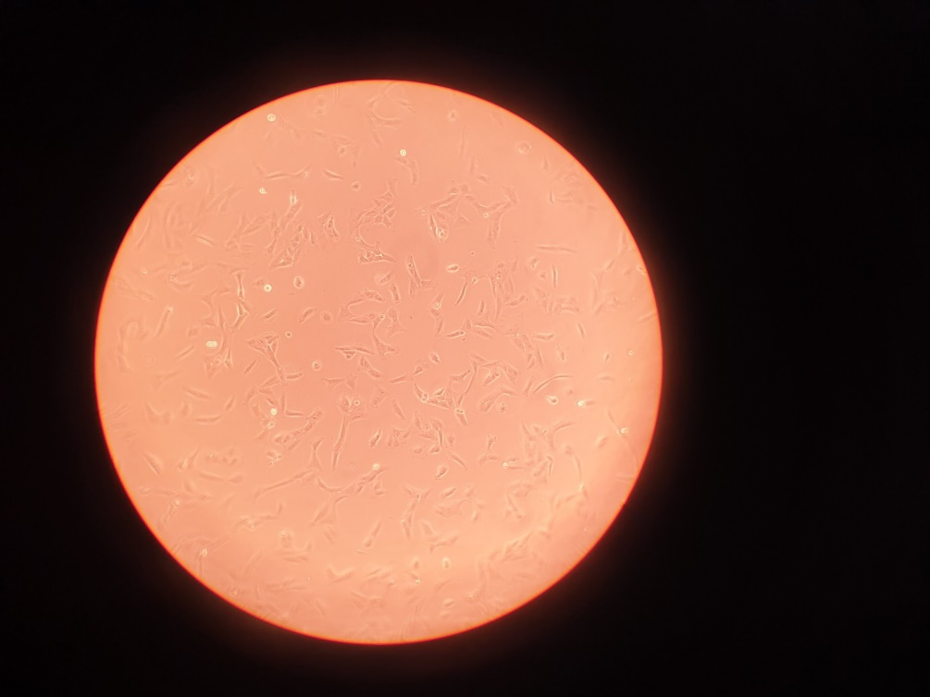
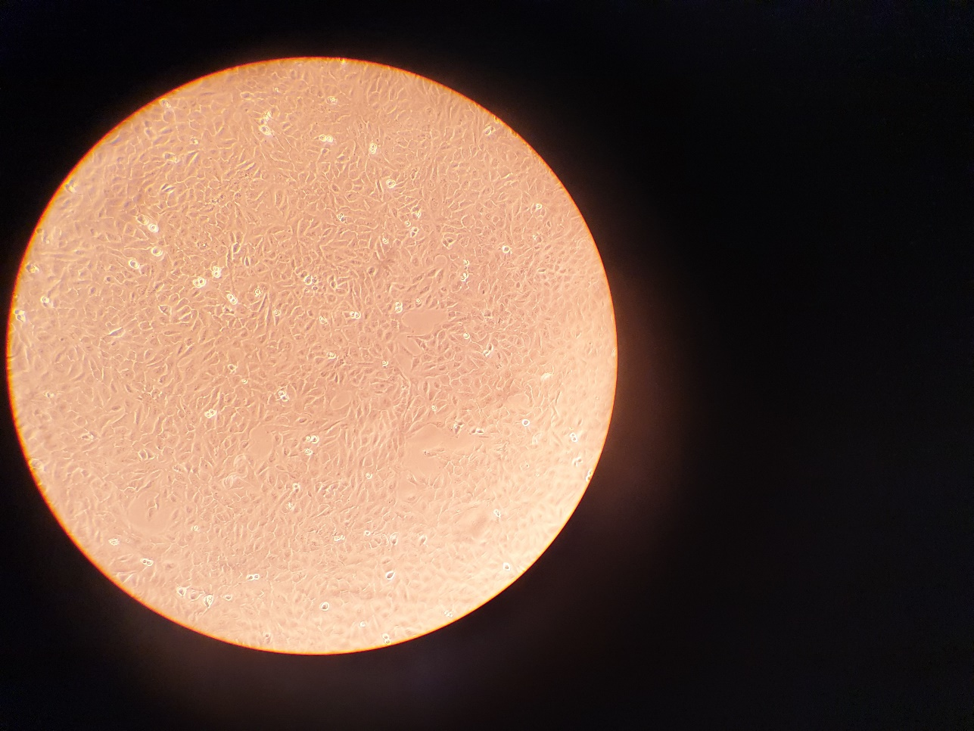
Cell culture
Growth characteristics of chosen cell line
Low confluence
High confluence
Fluorescent microscopic image

Slide 6
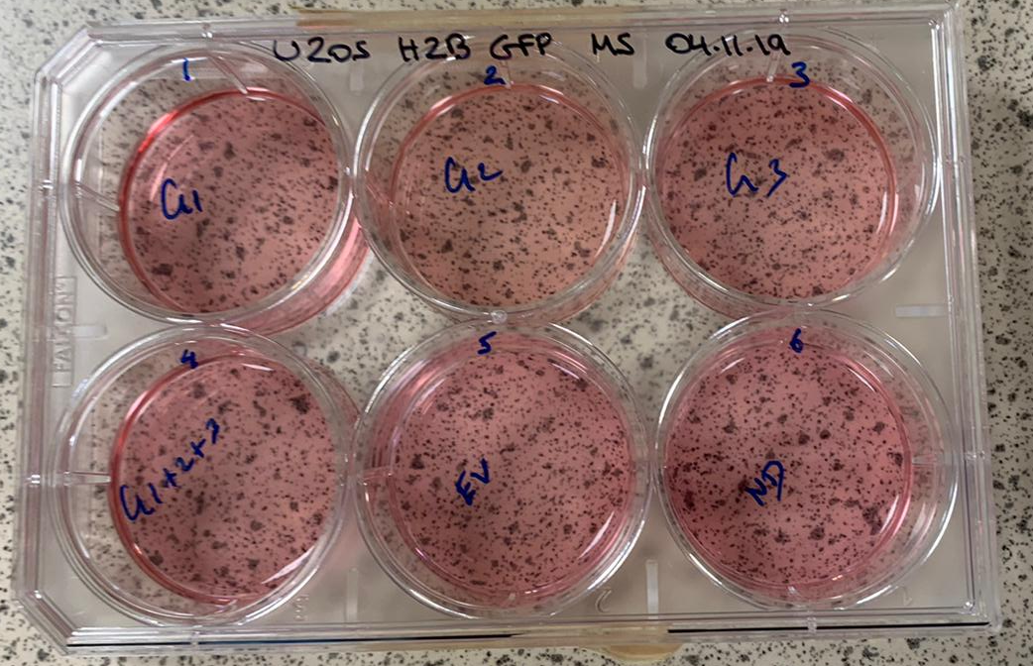
Transfection
Introducing CRISPR complex into cultured cells
6 well plate

Slide 7
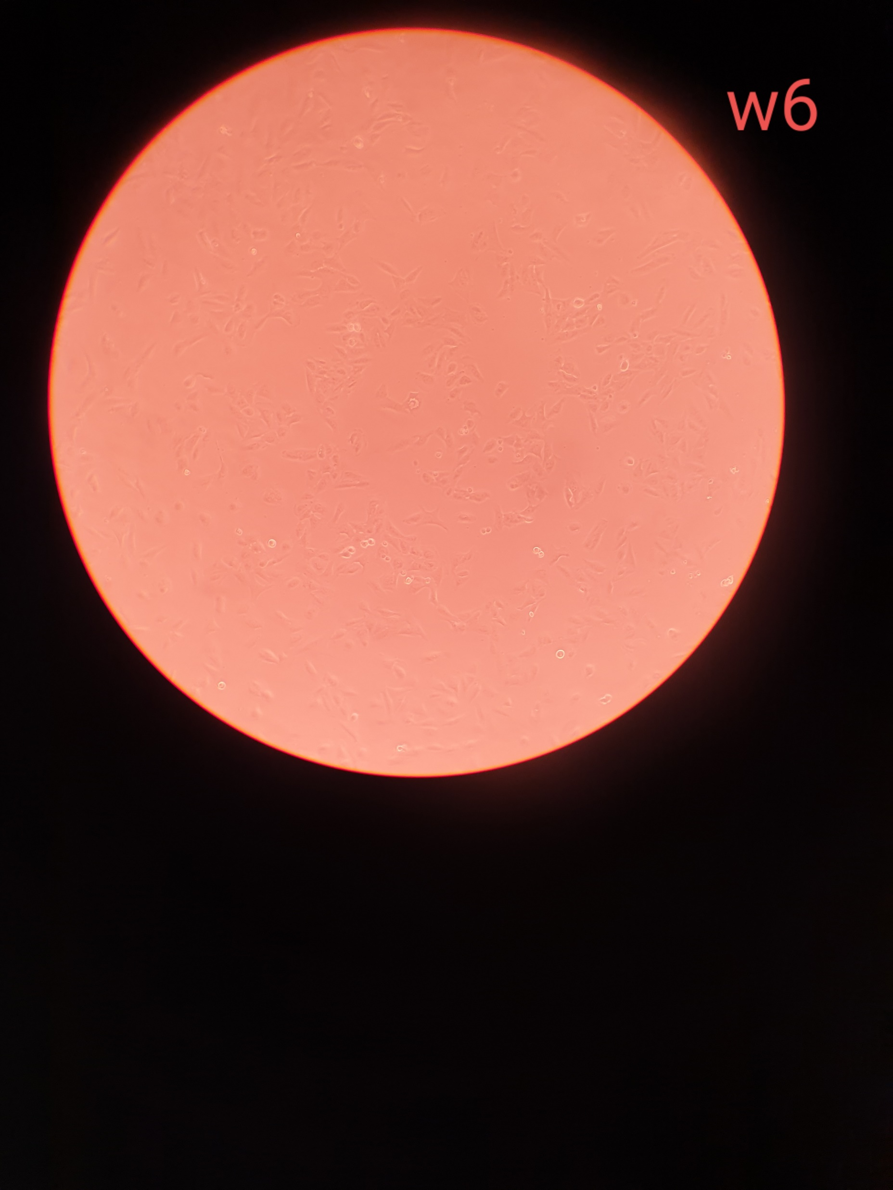
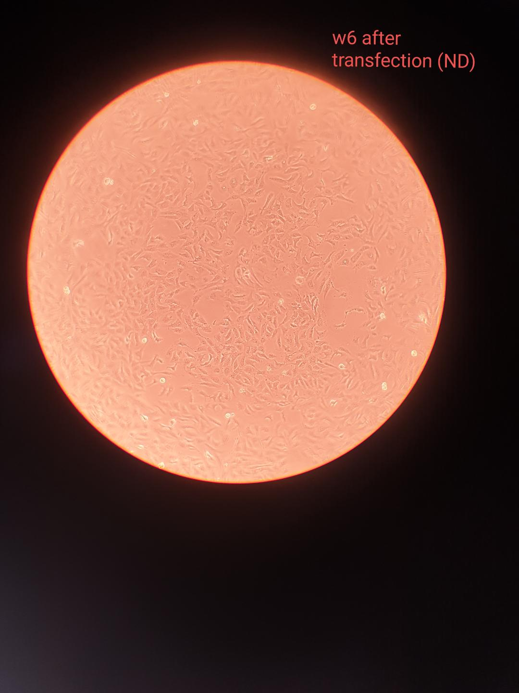
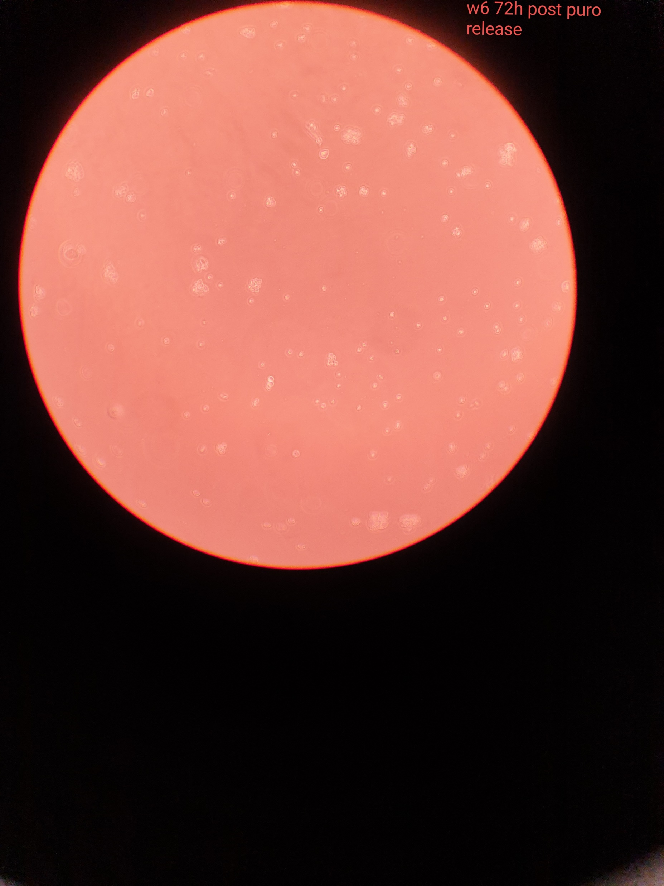
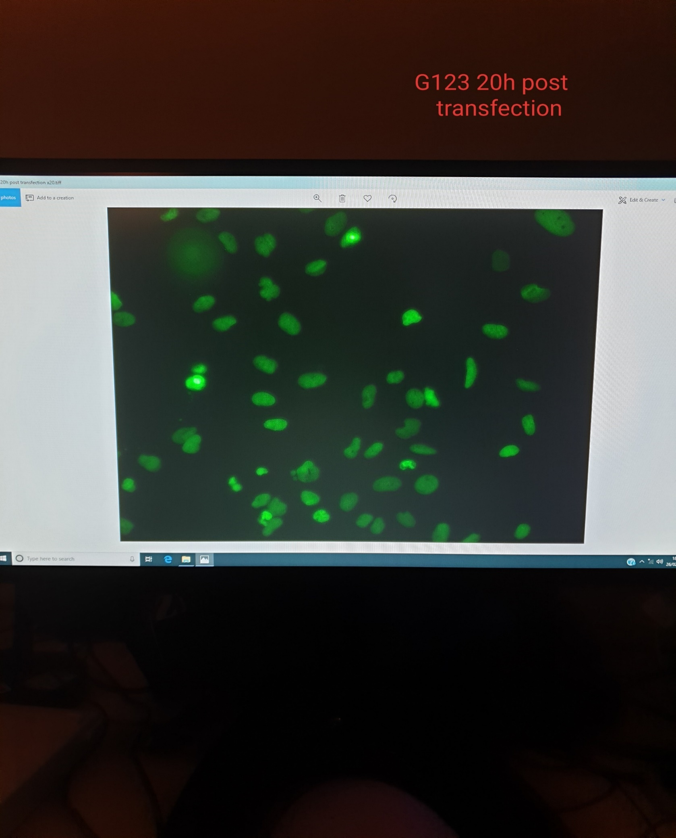
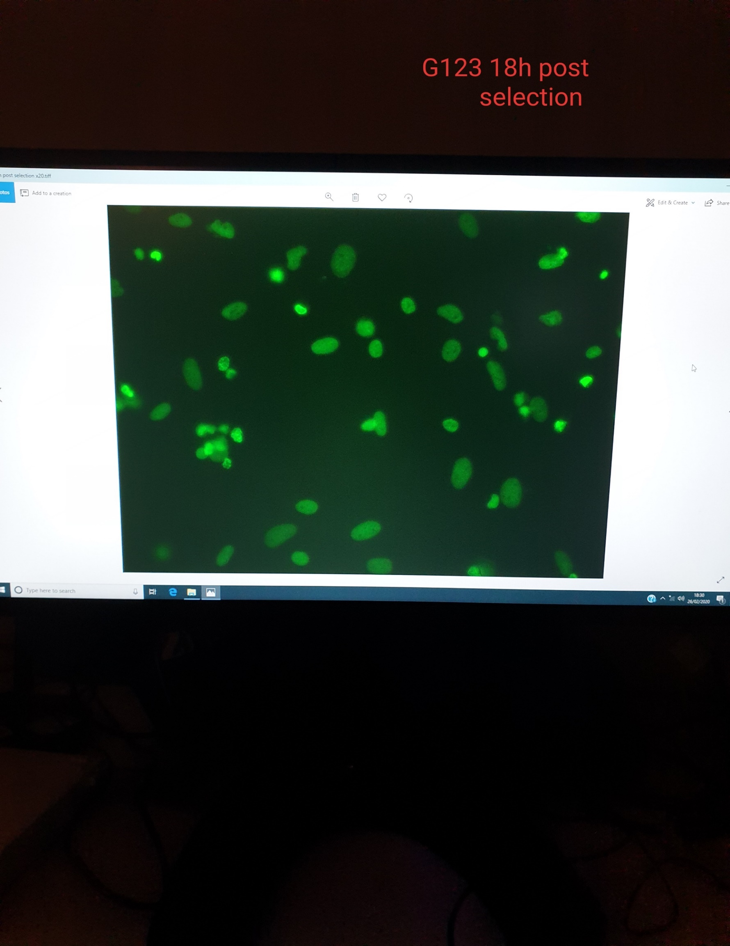
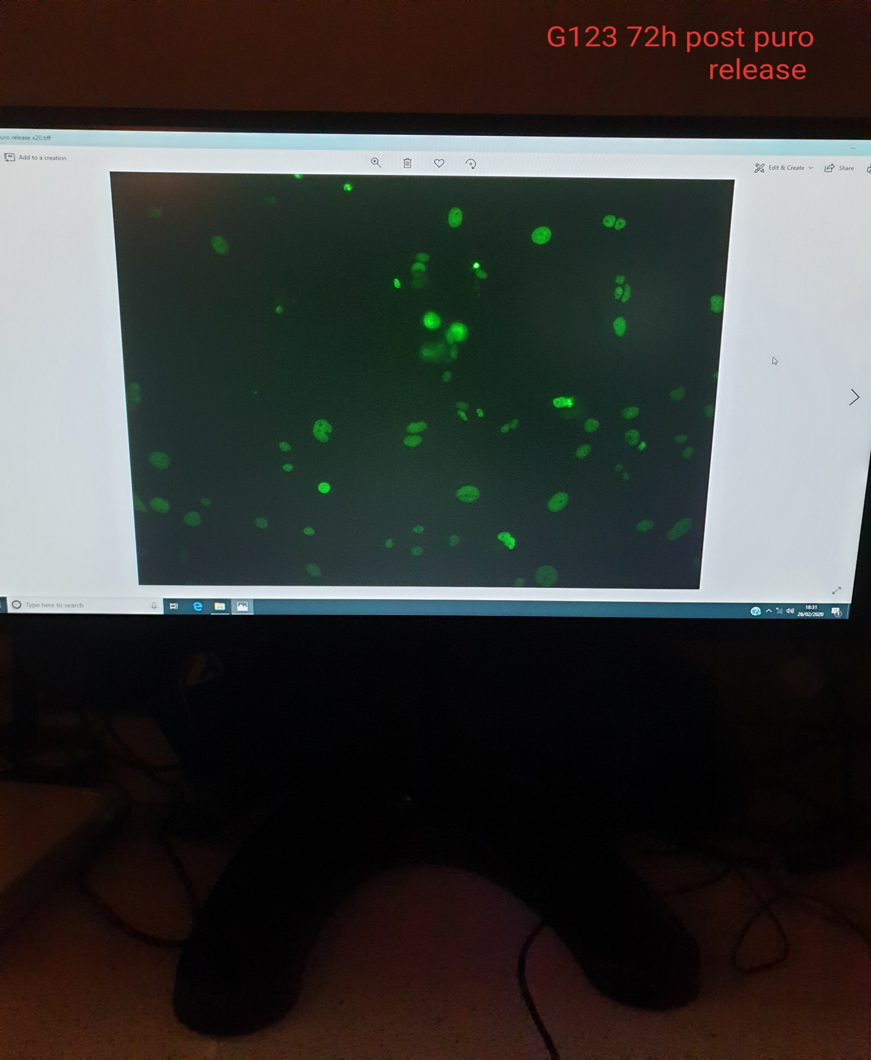
Selection
Before Transfection
Post Transfection
72h post selection release
Brightfield images
Fluorescent images
Selection of cells which contain the CRISPR complex

Slide 8
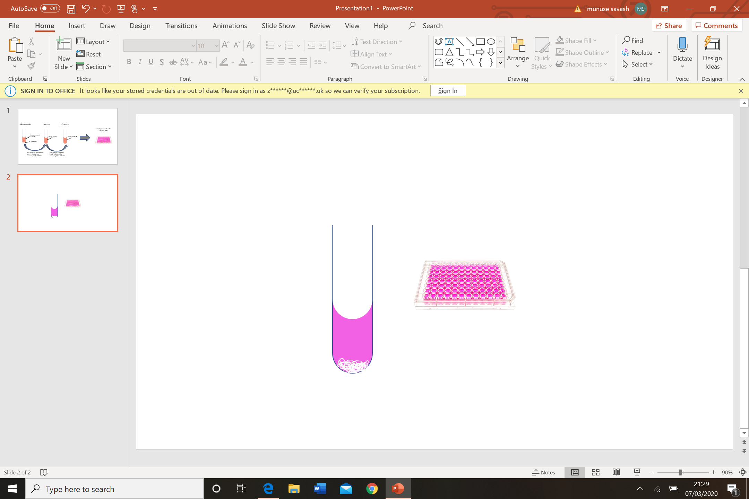
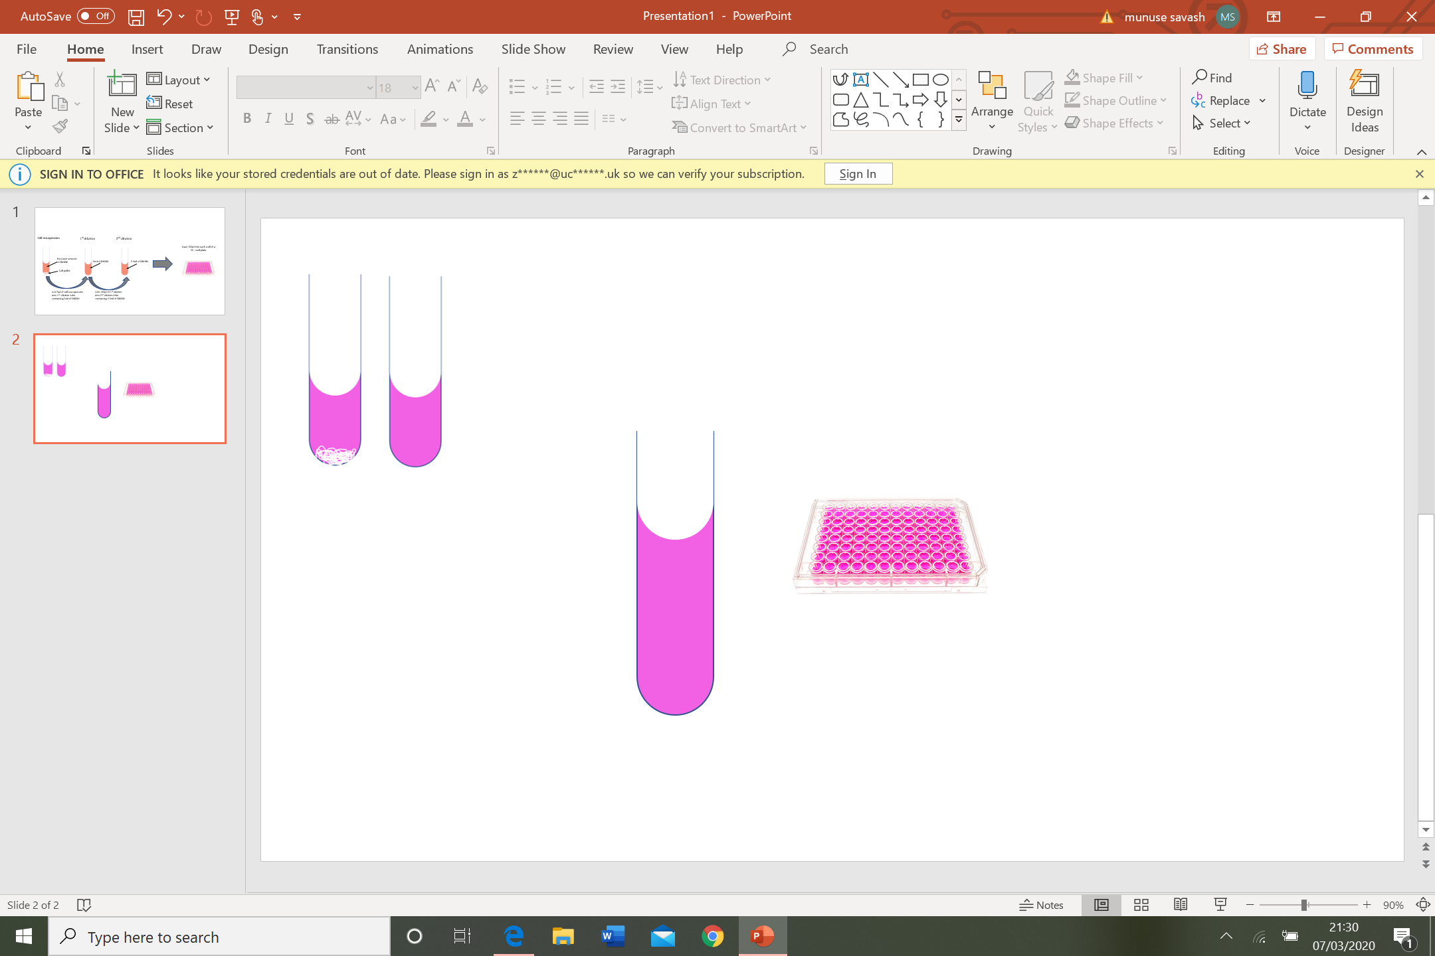
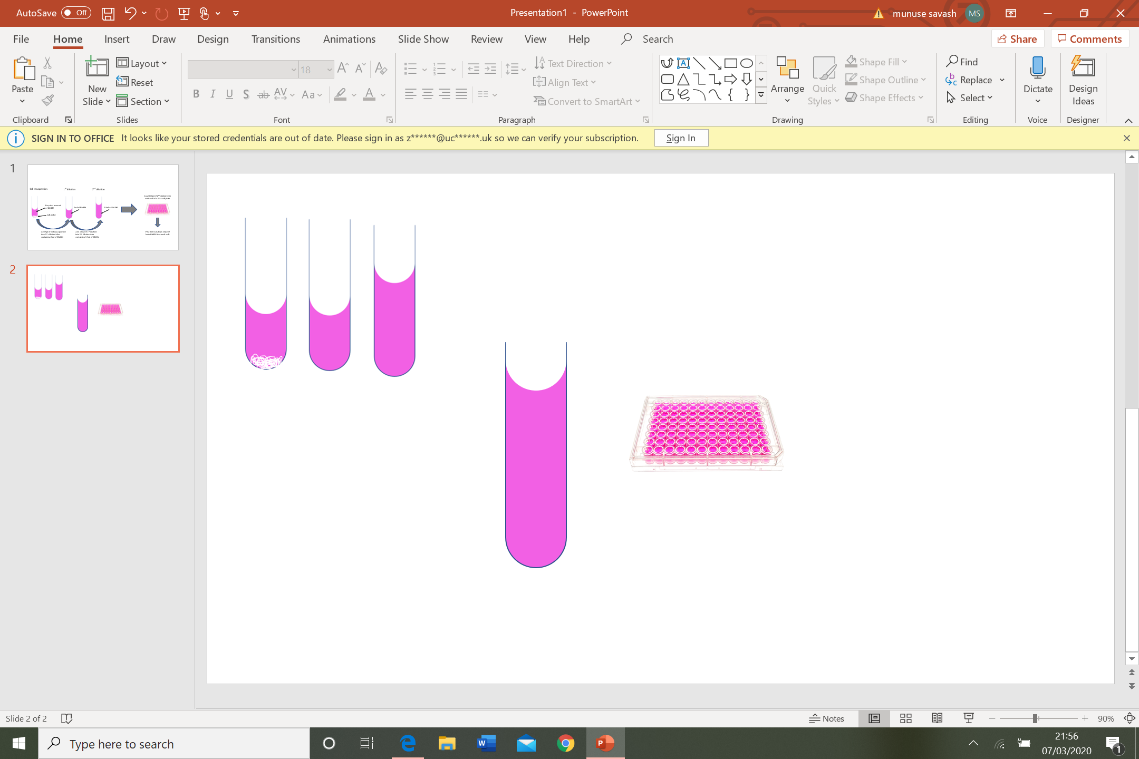
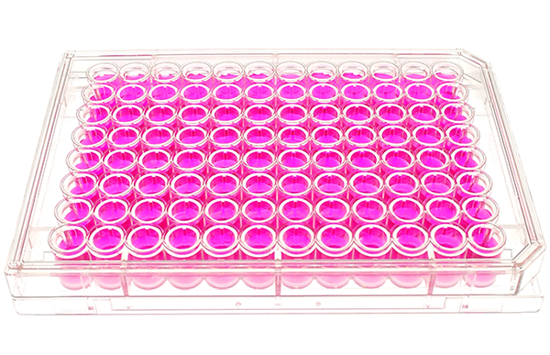
Isolation
1st dilution
2nd dilution
Load 100µl of 2nd dilution into each well of a 96 - well plate.
DMEM
Cell pellet
1 WELL = 1 CELL
Add 5µl of cell resuspension into 1st dilution tube
Add 100µl of 1st dilution into 2nd dilution tube
Isolating edited cells into single colonies

Slide 9
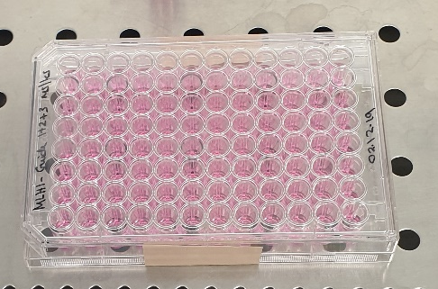
96 well monoclonal isolation plate

Slide 10
Monoclonal culture
Brightfield images
Fluorescent images

Slide 11
Fluorescent images

Slide 12
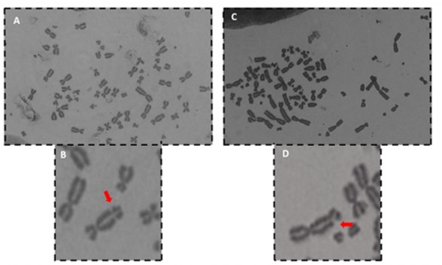
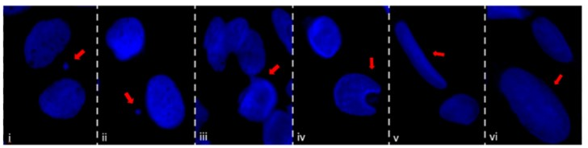
Phenotyping techniques
Gel electrophoresis
Metaphase spread
Nuclear morphology

Slide 15
Why is this workshop valuable?
Join a revolutionary field
Enhance laboratory skills
Open several opportunities
Networking opportunities
Assist in further education

Slide 16
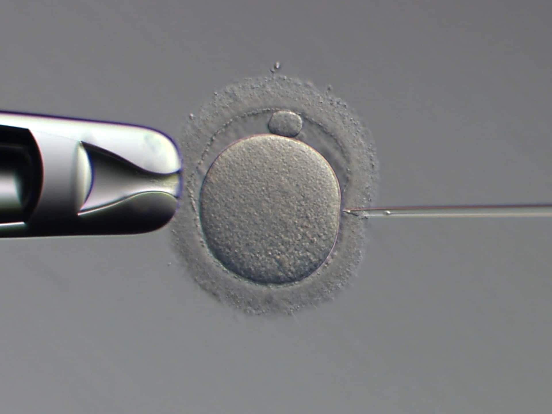
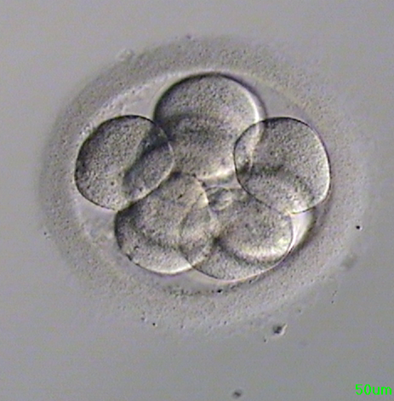
Translating the knowledge to embryo editing
A research fellow at Oxford University designed a project to introduce CRISPR into human embryos at two different stages of development.
At fertilisation
Day 3 embryo
Unpublished data

Slide 17
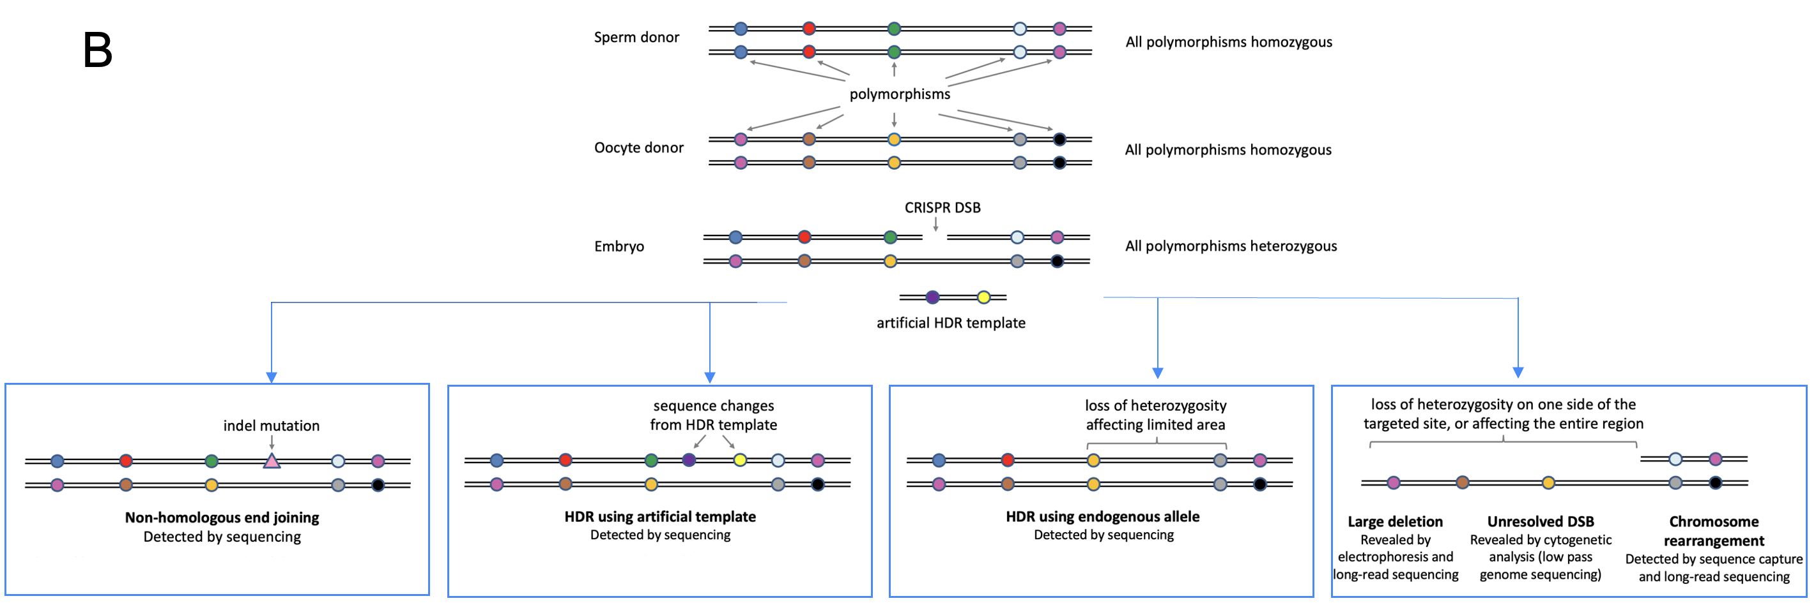
Unpublished data

Slide 18
Results
Unpublished data

Slide 19
Unpublished data

Slide 20
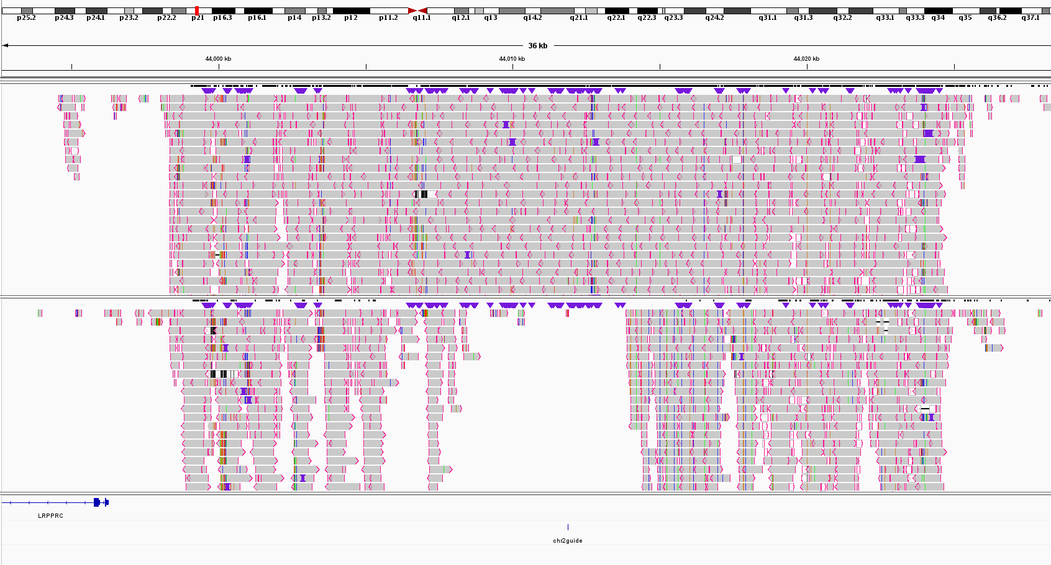
5914bp deletion
Chr2 guide

Slide 21
Conclusion
Successfully developed a method to detect large deletions.
Embryos at an early stage have little capacity for DNA repair.
Embryonic genome activation is crucial.
HDR most desired but NHEJ is the dominant repair mechanism.

